Slide 1
Evaluating deep learning models for electricity price forecasting
Mia Zdybek

Slide 2

About me
Mia Zdybek
Svea Solar
KTH
Planning/admin
App support
Developer intern
Bachelor of Engineering – Engineering Physics
Master of Engineering –Machine Learning

Slide 3
Agenda
Introduction to the problem of the thesis
Method
Results
Conclusions

Slide 4
1. Introduction to the problem

Slide 5


Motivation
Benefits of spot price prediction
Improved strategies for purchasing and selling electricity (financial gain)
Plan production and consumption so that losses are minimized, and grid balance is kept (sustainability)

Slide 6
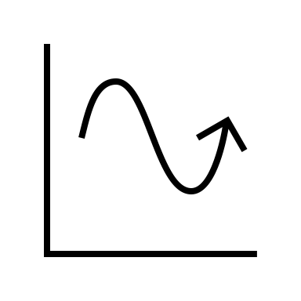
Objective
Find a relatively simple machine learning model that can predict spot prices 10-days ahead with good accuracy

Slide 7

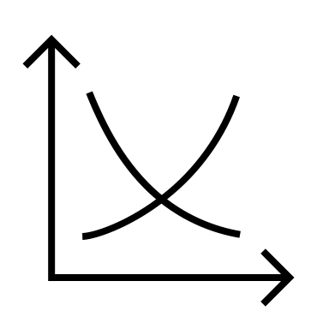

Problem
Electricity spot prices are unstable
Electricity spot prices depend on electricity demand and supply (and bidding strategies)
Demand and supply depend on unstable parameters:
- Weather
- Seasonal societal/behavior (holidays, weekly/monthly behavior)
- Politics
- Power source
- Transfer bottlenecks

Slide 8
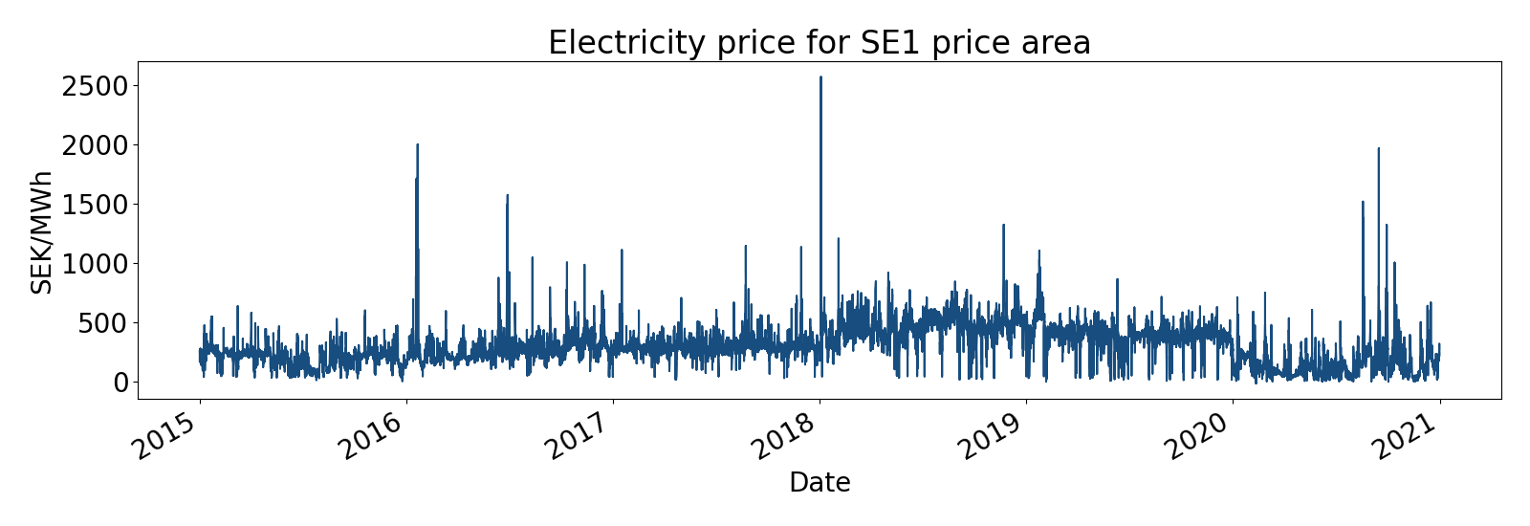
Spot prices
Erratic
Can change drastically from hour to hour

Slide 9
2. Method

Slide 10

Deep learning in EPF (Electricity price forecasting)
14 reviewed papers
Deep neural networks outperform other models, both machine learning and statistical models
The best performing model of the papers was usually LSTM, CNN and MLP or a hybrid of these

Slide 11

Method & Hypothesis
Method:
Gather relevant data
Build an LSTM, a CNN and an MLP
Evaluate them against each other and a benchmark model (ARIMA)
Fulfills objective

Slide 12



Nord Pool data
Nord Pool data
For each price area
Consumption
Consumption prognosis one day ahead
Production
Production prognosis for one day ahead
Wind power production prognosis
Hydro reservoir levels in Sweden

Slide 13



SMHI data
SMHI weather data
For each price area, average of
Air pressure
Air temperature
Wind speed
Relative humidity
Cloud cover

Slide 14

Calendar data
Calendar variables
Month integer (1-12)
Weekday integer (1-7)

Slide 15
Complete data set
Nord Pool data
For each price area
Consumption
Consumption prognosis one day ahead
Production
Production prognosis for one day ahead
Wind power production prognosis
Hydro reservoir levels in Sweden
SMHI weather data
For each price area, average of
Air pressure
Air temperature
Wind speed
Relative humidity
Cloud cover
Calendar variables
Month integer (1-12)
Weekday integer (1-7)

Slide 16
Data preprocessing
Min-max normalization of all data to [0,1]
Sequencing
70 % 15 % 15 % training, validation and test set split

Slide 17
4. Results

Slide 18
Grid search obtained models
MLP
LSTM
CNN

Slide 19
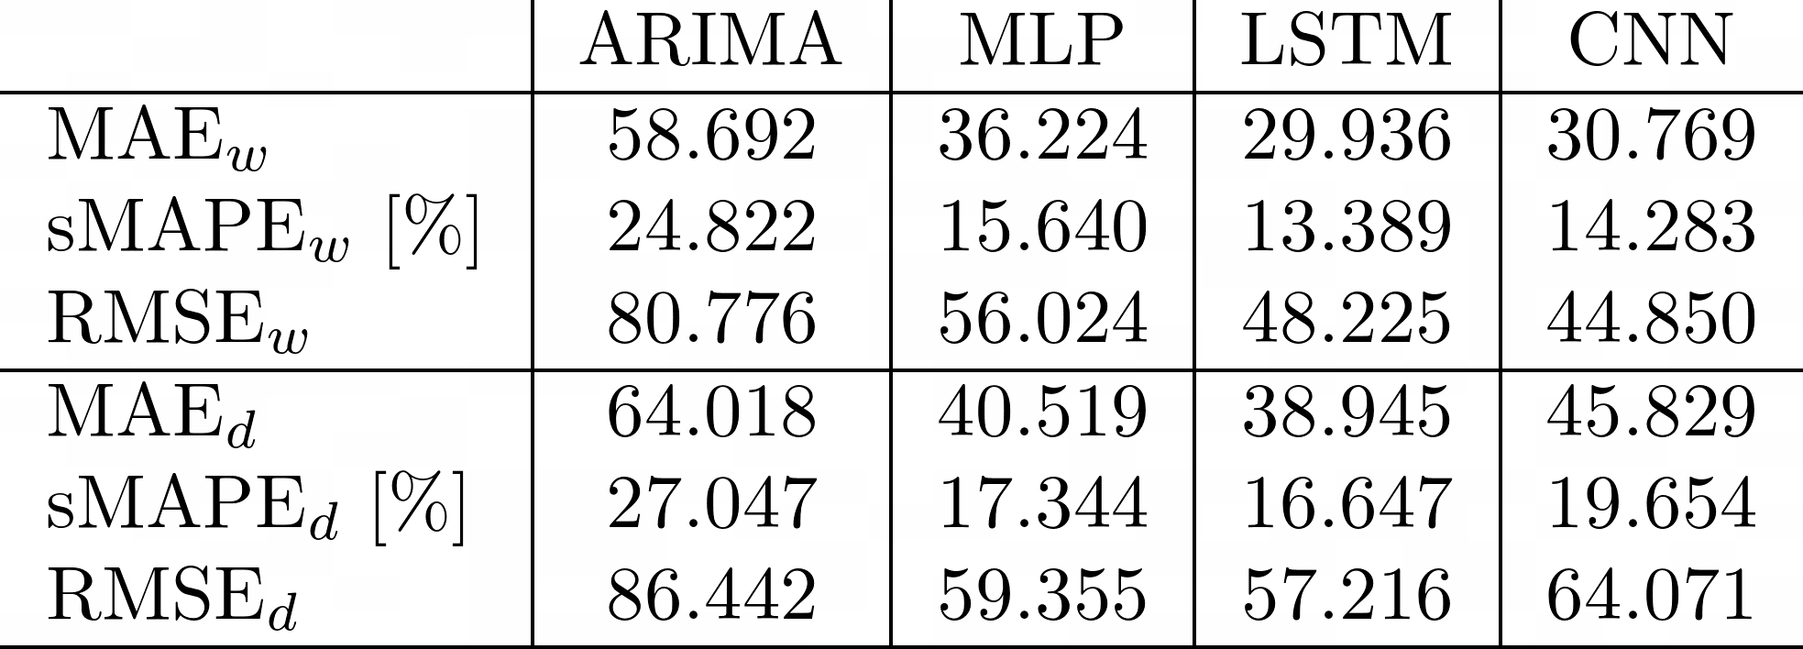
Evaluation metrics
Mean Absolute Error (MAE)
Root Mean Square Error (RMSE)
symmetric Mean Absolute Percentage Error (sMAPE).
Statistical model for comparison
Results

Slide 20
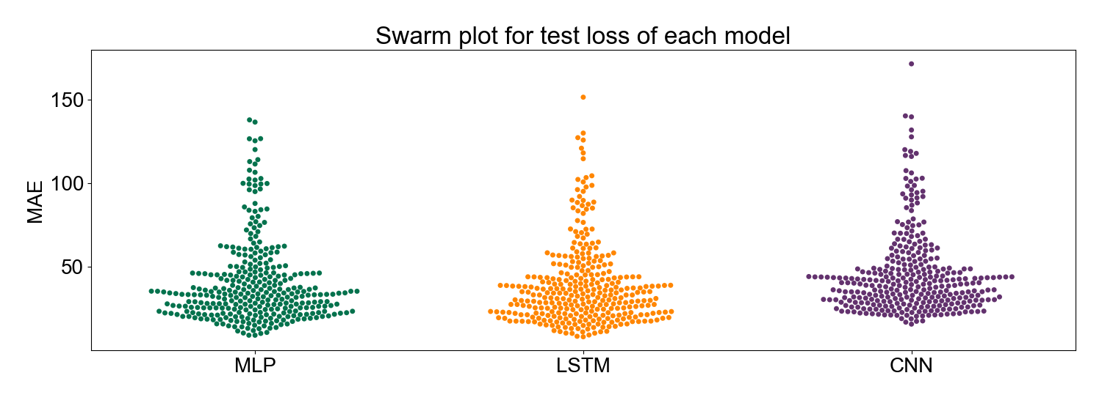
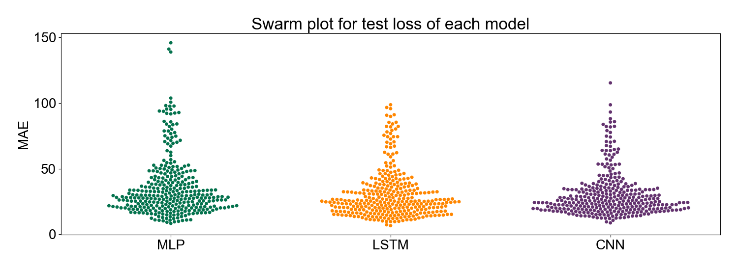
Resulting errors
Daily sequencing
Weekly sequencing

Slide 21
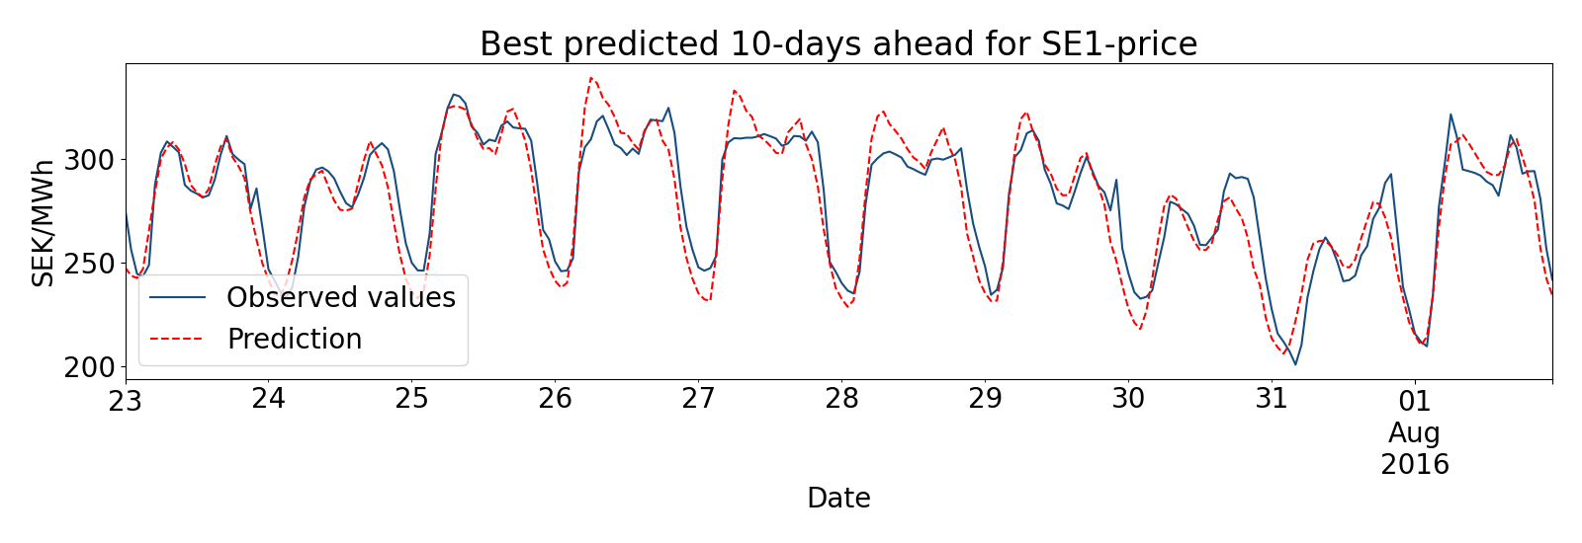
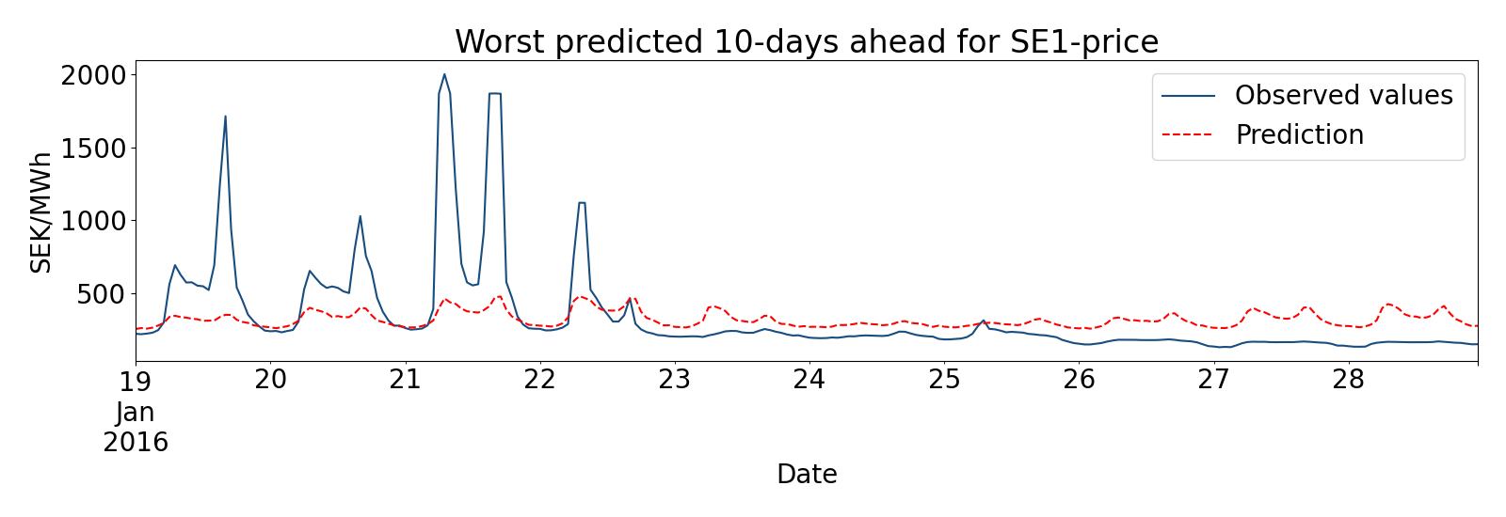
Resulting predictions MLP
(Weekly sequencing)
MAE = 8.369
MAE = 146.025

Slide 22
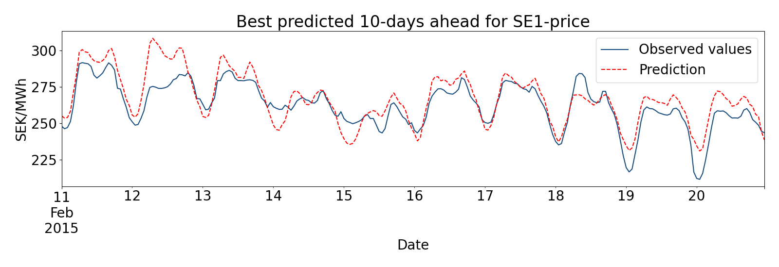
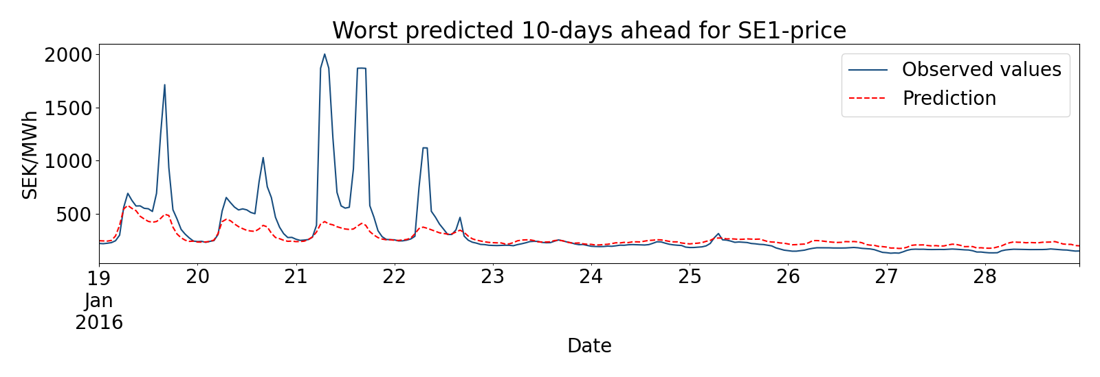
Resulting predictions LSTM
(Weekly sequencing)
MAE = 7.757
MAE = 116.508

Slide 23
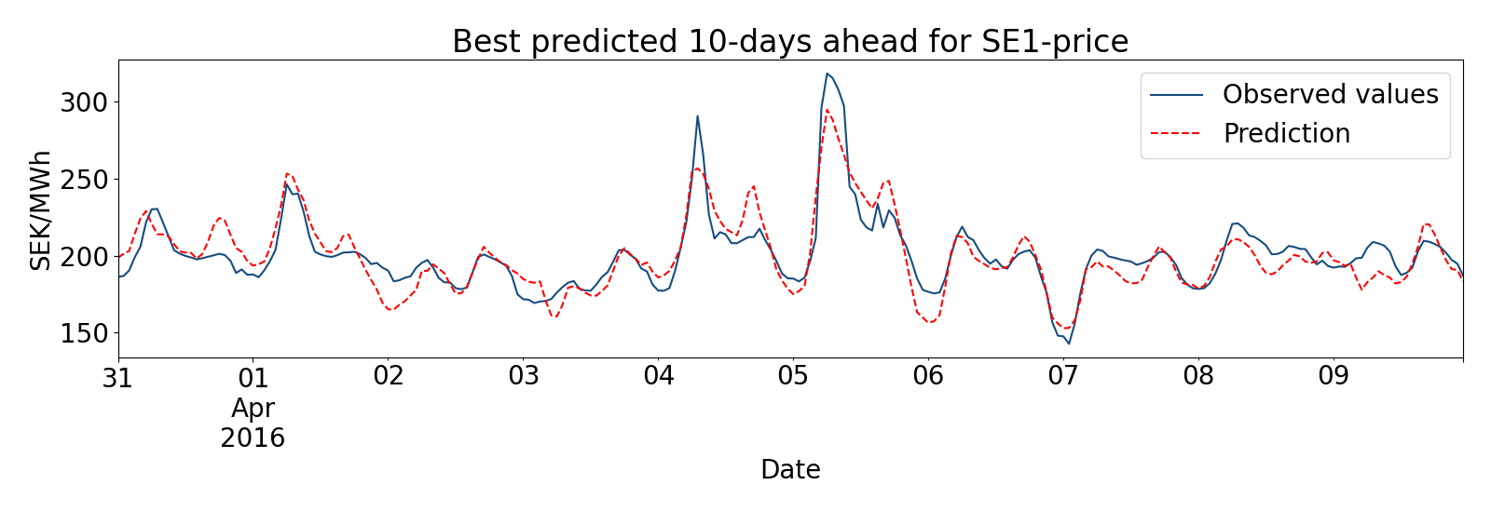

Resulting predictions CNN
(Weekly sequencing)
MAE = 8.788
MAE = 115.449

Slide 24
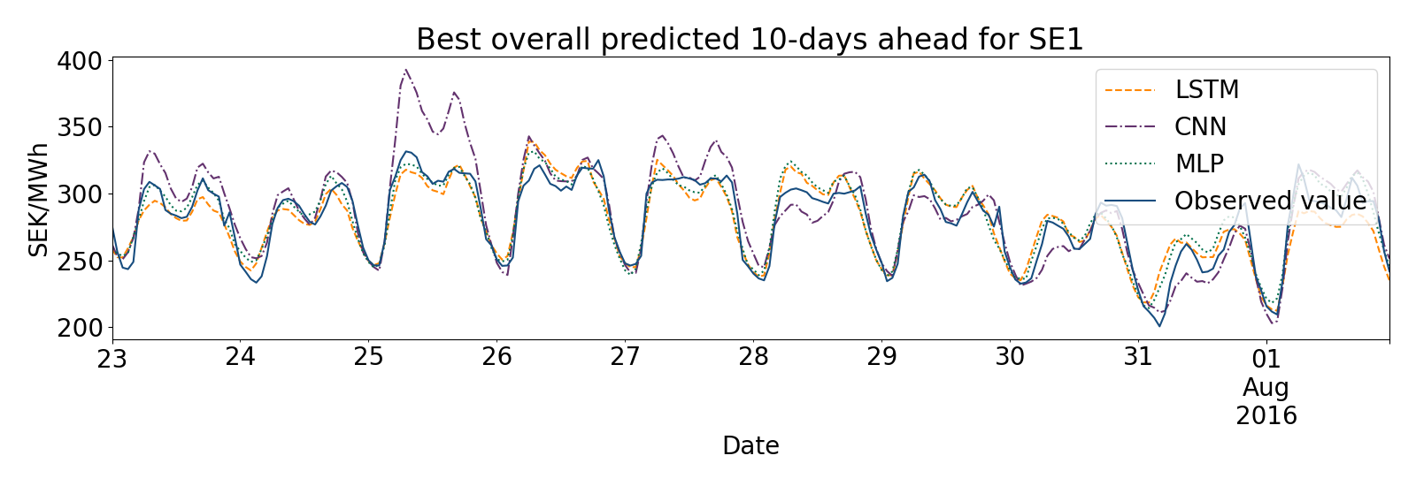
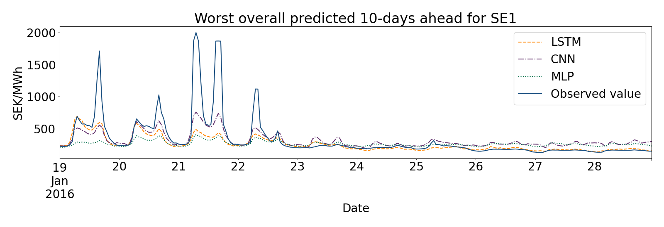
Comparison best and worst predictions

Slide 25
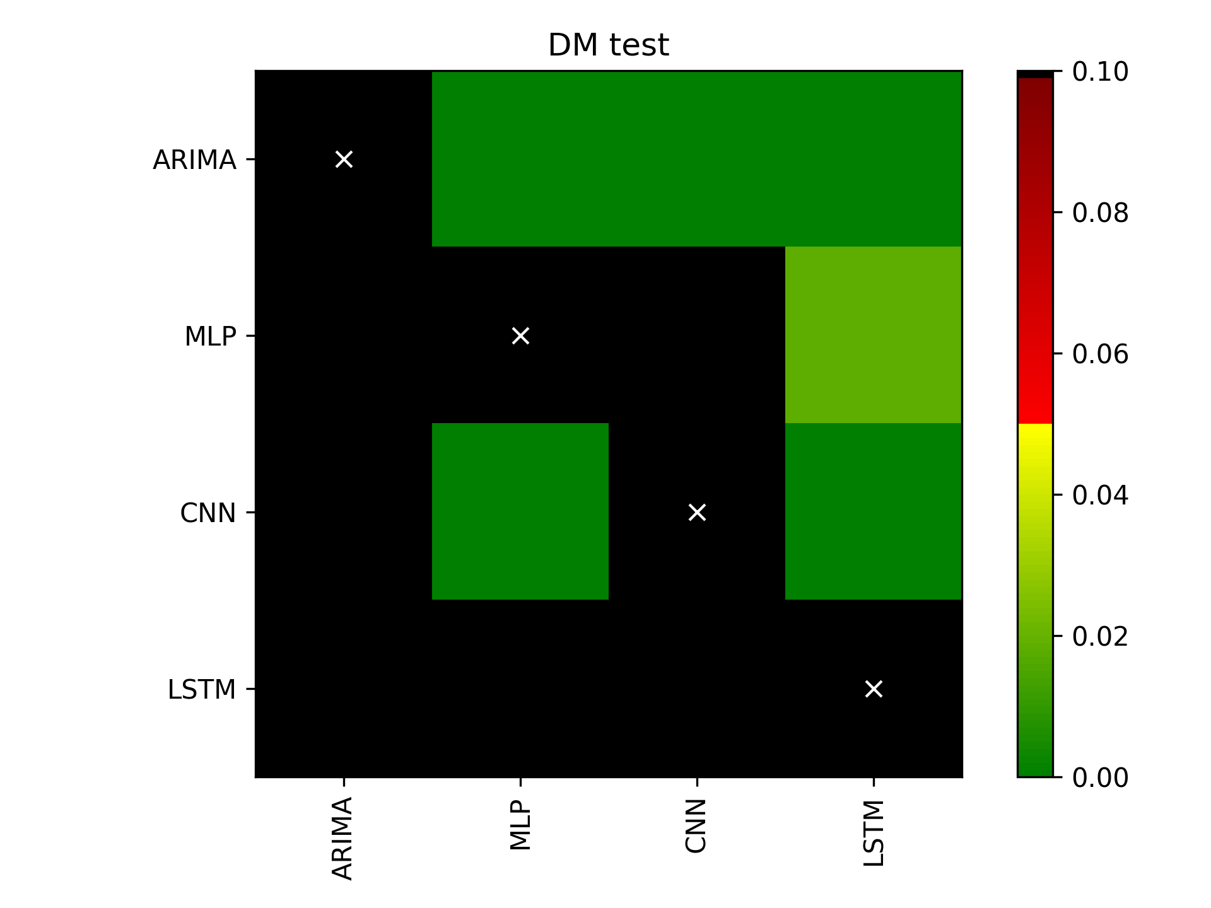
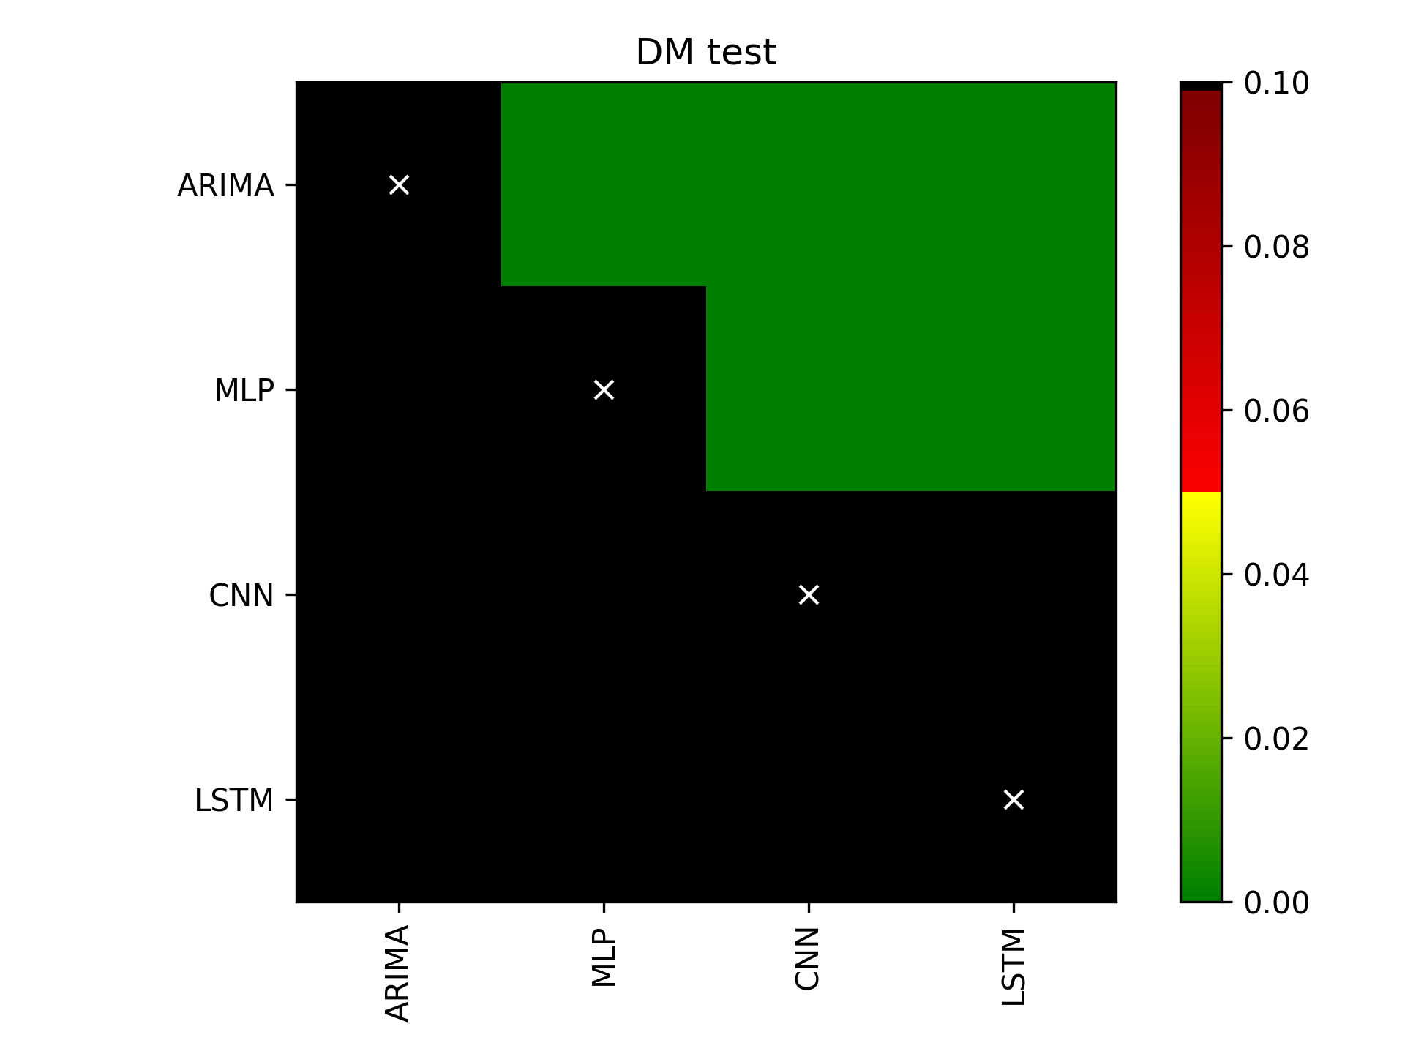
Diebold-Mariano test
Daily sequencing
Weekly sequencing
LSTM better than all others
LSTM and CNN better than all others

Slide 26
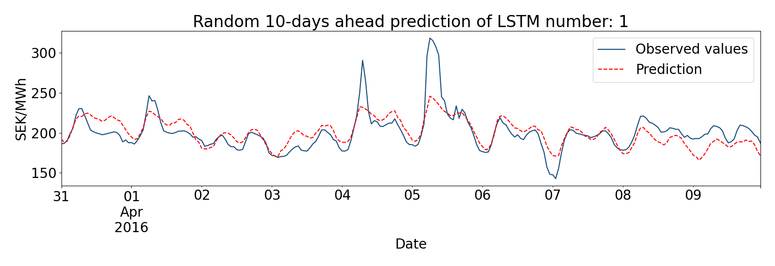
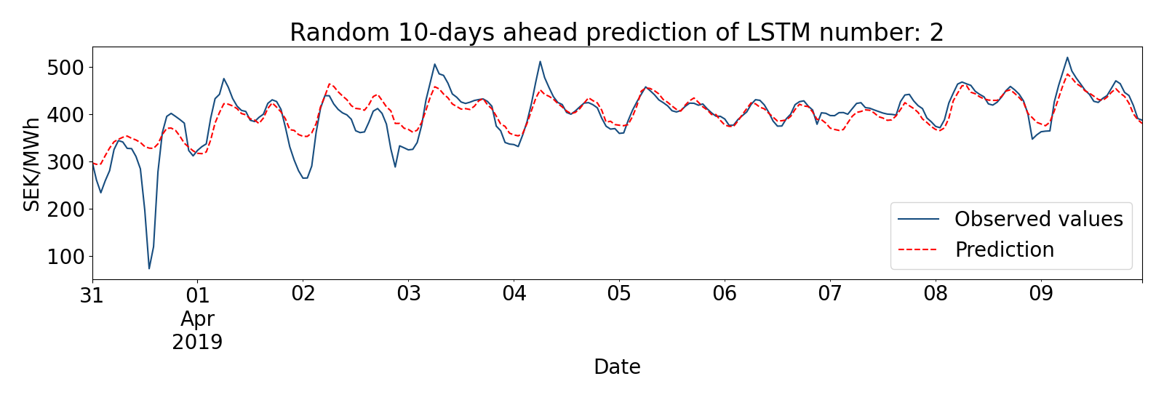
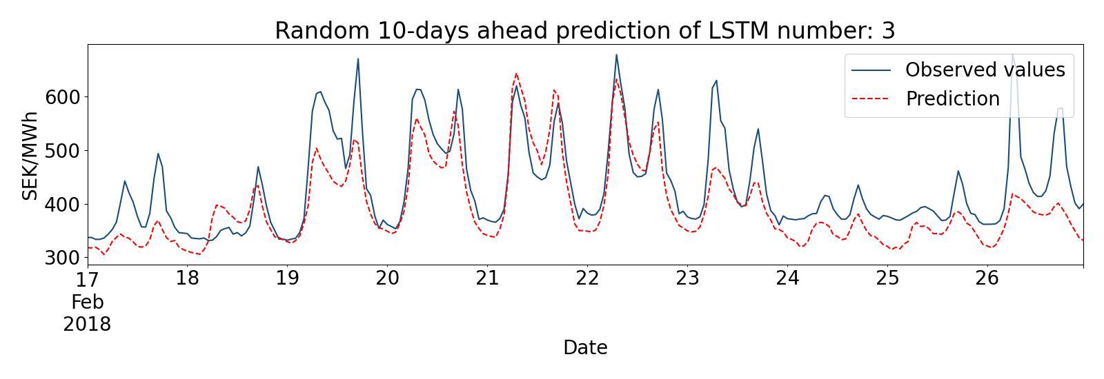
Randomly selected predictions LSTM

Slide 27
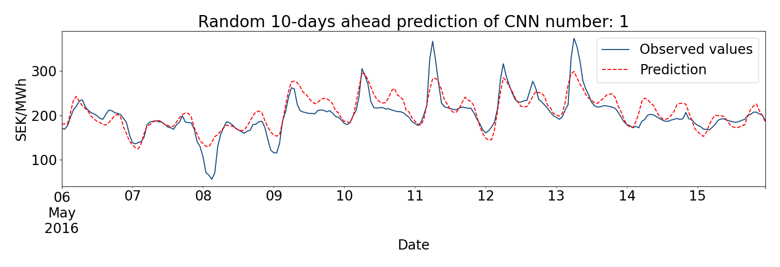
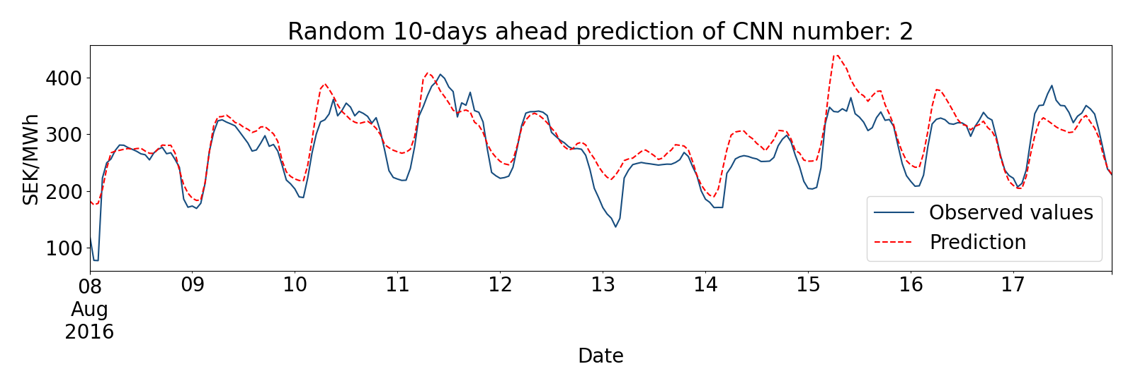
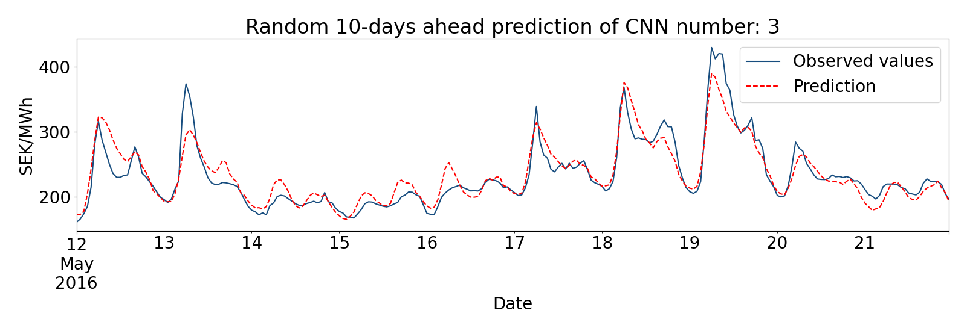
Randomly selected predictions CNN

Slide 28
5. Conclusions

Slide 29

Conclusions
Rather simple deep learning models can predict prices with high accuracy, except for the most extreme sudden peaks.
Using weekly sequencing yields higher accuracy
All the deep networks outperformed the benchmark statistical model. In particular, LSTM and CNN with weekly sequencing performed best.

Slide 30


Thank you!

